Slide 1
Software Metrics
Dave Elliman and
P Blanchfield

Slide 2
Definitions
Measure – A quantitative indication of extent, amount, dimension, capacity, or size of some attribute of a product or process.
  for example: Lines of code (LOC), Number of errors
Metric - quantitative measure of degree to which a system, component or process possesses a given attribute. That is to say a “derived measure.” May involve “guesstimates” where human processes are concerned.
  for example: Error density

Slide 3
Why Measure Software?
To determine the quality of the current product or process and to make informed comparisons
To predict qualities of a product/process
(might use Ishikawa’s tools)
To improve quality of a product/process (often continuously – kaizen)

Slide 4
Example Metrics
Error rates / Defect rates
A defect is a failure to do something
An error is a wrong result or illegal action
Code generation rates
Measured by:
  per person
  per team
  per project
    Will involve aggregation – see later
Errors should be categorized by origin, type etc.

Slide 5
Metrics can be evaluated on:
Products
  Explicit results of software development activities
  Deliverables, documentation, other artifacts produced
Processes
  Activities related to production of software
Resources
  Inputs into the software development activities
  hardware, knowledge, people

Slide 6
Reference Compendium
Good (modernish) list of measures
  http://arisa.se/compendium/

Slide 7
Process Metrics
Process Metrics
  Rates of production / productivity
  Quality of estimates
  Burn down rate – project velocity
  Refactoring rate
These can lead to long term process improvement
  Need “kaizen” days

Slide 8
Product Metrics
Product Metrics
  Error densities
  Complexity measures
  Code quality measures
  Speed and memory measures
  Code profiles etc.
  Track potential risks
  Uncover problem areas
  Adjust workflow or tasks
Evaluate teams ability to control quality

Slide 9
Types of Measures
Direct Measures
Cost, effort, LOC, speed, memory
Indirect Measures (need human estimate)
Functionality, quality, efficiency, reliability, maintainability

Slide 10
Size-Oriented Metrics
Size of the software produced
LOC - Lines Of Code or KLOC - 1000 Lines Of Code
SLOC – Statement Lines of Code (ignore whitespace)
Typical Measures:
  Errors/KLOC, Defects/KLOC, Cost/LOC, Documentation Pages/KLOC

Slide 11
LOC Metrics
Easy to use
Easy to compute
Language & programmer dependent
Can be counter-productive if used as a basis for reward!

Slide 12
Complexity Metrics
LOC - a function of complexity
Language and programmer dependent
Halstead’s Software Science (entropy measures)
  n₁ - number of distinct operators
  n₂ - number of distinct operands
  N₁ - total number of operators
  N₂ - total number of operands

Slide 13
Example
if (k < 2)
{
if (k > 3)
x = x*k;
}
Distinct operators: if ( ) { } > < = * ;
Distinct operands: k 2 3 x
n₁ = 10
n₂ = 4
N₁ = 13
N₂ = 7

Slide 14

Halstead’s Metrics
Amenable to experimental verification [1970s]
Program length: N = N₁ + N₂
Program vocabulary: n = n₁ + n₂
Estimated length: = n₁ log₂ n₁ + n₂ log₂ n₂
  Close estimate of length for well structured programs
Purity ratio: PR = /N

Slide 15

Program Complexity
Volume: V = N log₂ n
  Number of bits to provide a unique designator for each of the n items in the program vocabulary.
Difficulty
Program effort: E=D*V
  This is a good measure of program understandability

Slide 16
McCabe’s Complexity Measures
McCabe’s metrics are based on a control flow representation of the program.
A program graph is used to depict control flow.
Nodes represent processing tasks (one or more code statements)
Edges represent control flow between nodes

Slide 17
Flow Graph Notation
While
Sequence
If-then-else
Until

Slide 18
Cyclomatic Complexity
Set of independent paths through the graph (basis set)
V(G) = E – N + 2
  E is the number of flow graph edges
  N is the number of nodes
V(G) = P + 1
  P is the number of predicate nodes (branching)
See http://en.wikipedia.org/wiki/Cyclomatic_complexity

Slide 19
Example
i = 0;
while (i<n-1) do
j = i + 1;
while (j<n) do
if A[i]<A[j] then
swap(A[i], A[j]);
end do;
i=i+1;
end do;

Slide 20
Flow Graph
1
2
3
7
4
5
6

Slide 21
Computing V(G)
V(G) = 9 – 7 + 2 = 4
V(G) = 3 + 1 = 4
Basis Set
  1, 7
  1, 2, 6, 1, 7
  1, 2, 3, 4, 5, 2, 6, 1, 7
  1, 2, 3, 5, 2, 6, 1, 7

Slide 22
Another Example
1
9
2
4
3
5
6
7
8
What is V(G)?

Slide 23
Meaning
V(G) is the number of (enclosed) regions/areas of the planar graph
Number of regions increases with the number of decision paths and loops
This is a quantitative measure of the number of tests needed
It correlates very well with the rate of errors
Experimental data shows value of V(G) should be no more then 10 - testing is very difficulty above this value

Slide 24
McClure’s Complexity Metric
Complexity = C + V
  C is the number of comparisons in a module
  V is the number of control variables referenced in the module
  decisional complexity
Similar to McCabe’s but with regard to control variables

Slide 25
Metrics and Software Quality
FURPS
Functionality - features of system
Usability – aesthesis, documentation
Reliability – frequency of failure, security
Performance – speed, throughput
Supportability – maintainability

Slide 26
Measures of Software Quality
Correctness – degree to which a program operates according to specification
  Defects/KLOC
  Defect is a verified lack of conformance to requirements
  Failures/hours of operation
Maintainability – degree to which a program is open to change
  Mean time to change
  Change request to new version (Analyze, design etc)
  Cost to correct
Integrity - degree to which a program is resistant to outside attack
  Fault tolerance, security & threats
Usability – easiness to use
  Training time, skill level necessary to use, Increase in productivity, subjective questionnaire or controlled experiment

Slide 27
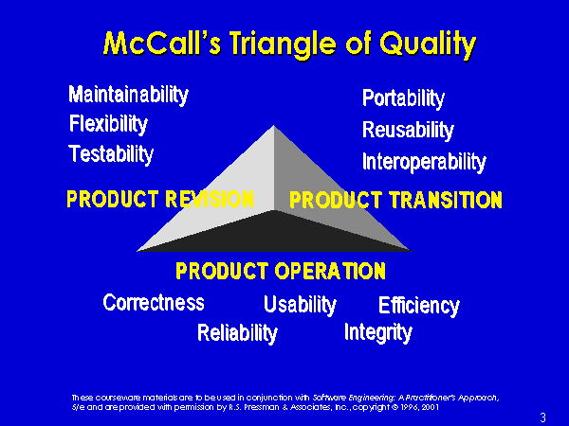
McCall’s Triangle of Quality
M
a
i
n
t
a
i
n
a
b
i
l
i
t
y
M
a
i
n
t
a
i
n
a
b
i
l
i
t
y
P
o
r
t
a
b
i
l
i
t
y
P
o
r
t
a
b
i
l
i
t
y

Slide 28
Quality Model
product
operation
revision
transition
reliability
efficiency
usability
maintainability
testability
portability
reusability
Metrics

Slide 29
_x001a__x001a__x001a_This is all very old material…
McCall’s quality factors were proposed in the early 1970s. They are as valid today as they were at that time.
Software built to conform to these factors will exhibit high quality even if there are dramatic changes in technology.

Slide 30
Object-Oriented Metrics
Cohesion (internal interaction)
Coupling (external interaction) - a function of input and output parameters, global variables, and objects referenced
Within class metrics
Measures based on inheritance
Complexity of program flow - (e.g., cyclomatic complexity)

Slide 31
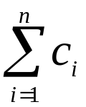
Weighted Methods per Class
WMC =
c_{i} is the complexity (e.g., cyclomatic) of each method
Reasoning:
The number of methods and complexity of methods is an indicator of how much time and effort is required to develop and maintain the object
The larger the number of methods in an object, the greater the potential impact on the children
Objects with large number of methods are likely to be more application specific, limiting the possible reuse

Slide 32
Depth of Inheritance Tree
DIT is the maximum length from a node to the root (base class)
Reasoning:
Inheritance is a form of strong coupling
Lower level subclasses inherit a number of methods making behavior harder to predict
Deeper trees indicate greater design complexity

Slide 33
Number of Children
NOC is the number of subclasses immediately subordinate to a class
Reasoning:
As NOC grows, reuse increases - but the abstraction may be diluted
NOC gives an idea of the potential influence a class has on the design: classes with large number of children may require more testing
Some of the best design patterns have a large NOC in a flat hierarchy. This is not really a good complexity measure in my opinion.

Slide 34
Coupling between Classes
CBO is the number of collaborations between two classes (fan-out of a class C)
  the number of other classes that are referenced in the class C (a reference to another class, A, is an reference to a method or a data member of class A)
Reasoning:
As collaboration increases reuse decreases (dependency or code rot)
High fan-outs represent class coupling to other classes/objects and thus are undesirable

Slide 35
Fan-in measure per class
High fan-ins represent good object designs and high level of reuse
It’s not possible to maintain high fan-in and low fan outs across the entire system (e.g. The DI pattern has high values in setup but low in actual code)
One could use (FanOut – Fan-In) as a fair measure of coupling (but “instability” more used – next slide)

Slide 36
Abstractness
Abstractness (A) The ratio of the number of abstract classes (and interfaces) in the analyzed package to the total number of classes in the analyzed package. The range for this metric is 0 to 1, with A=0 indicating a completely concrete package and A=1 indicating a completely abstract package.

Slide 37
Instability
Instability (I) The ratio of efferent coupling (Ce) to total coupling (Ce + Ca) such that I = Ce / (Ce + Ca). This metric is an indicator of the package's resilience to change.

Slide 38
Response for a Class
RFC is the number of methods that could be called in response to a message to a class (local + remote)
Reasoning:
As RFC increases
The testing effort increases
The greater the complexity of the object
The code becomes harder to understand

Slide 39
Lack of Cohesion in Methods
Class C_{k} with n methods M₁,…M_{n}
I_{j} is the set of instance variables used by M_{j}

Slide 40
LCOM
There are n such sets I₁ ,…, I_{n}
  P = {(I_{i}, I_{j}) | (I_{i} ∩ I_{j} ) = ∅}
  Q = {(I_{i}, I_{j}) | (I_{i} ∩ I_{j} ) ≠ ∅}
If all n sets I_{i} are ∅ then P = ∅
LCOM = |P| - |Q|, if |P| > |Q|
LCOM = 0 otherwise

Slide 41
Example LCOM
Take class C with M₁, M₂, M₃
I₁ = {a, b, c, d, e}
I₂ = {a, b, e}
I₃ = {x, y, z}
P = {(I₁, I₃), (I₂, I₃)}
Q = {(I₁, I₂)}
Thus LCOM = 1

Slide 42
Explanation
LCOM is the number of empty intersections minus the number of non-empty intersections
This is a notion of degree of similarity of methods
If two methods use common instance variables then they are similar
LCOM of zero is not maximally cohesive
|P| = |Q| or |P| < |Q|

Slide 43
Class Size
CS
  Total number of operations
  Number of attributes
May be an indication of too much responsibility for a class
Very simple measure!

Slide 44
Number of Operations Overridden
NOO
A large number for NOO indicates possible problems with the design
Poor abstraction in inheritance hierarchy

Slide 45
Number of Operations Added
NOA
The number of operations added by a subclass
As operations are added it is farther away from super class
As depth increases NOA should decrease

Slide 46
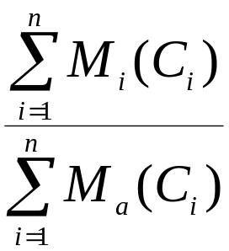
Method Inheritance Factor
MIF = .
M_{i}(C_{i}) is the number of methods inherited and not overridden in C_{i}
M_{a}(C_{i}) is the number of methods that can be invoked with C_{i}
M_{d}(C_{i}) is the number of methods declared in C_{i}

Slide 47
MIF
M_{a}(C_{i}) = M_{d}(C_{i}) + M_{i}(C_{i})
All that can be invoked = new or overloaded + things inherited
MIF is [0,1]
MIF near 1 means little specialization
MIF near 0 means large change

Slide 48
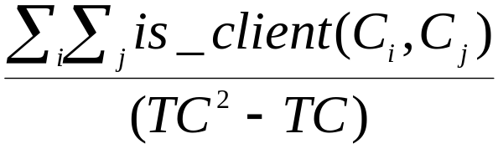
Coupling Factor
CF= .
is_client(x,y) = 1 iff a relationship exists between the client class and the server class. 0 otherwise
(TC²-TC) is the total number of relationships possible
CF is [0,1] with 1 meaning high coupling

Slide 49
Encapsulation
Lack of cohesion
Percent public and protected
Public access to data members

Slide 50
Inheritance
Number of root classes
Inheritance Fan in – multiple inheritance
NOC, DIT, etc.

Slide 51
How do you combine per class metrics?
Per class metrics tend to be better if a lot of small classes are used
If you sum them over all classes the value rises with the size of the system
Average value is useful
Or normalise over KLOC
System coupling measures also increase with the total system size. Again may be best to normalise over KLOC
  Good reference paper coming later

Slide 52
Using Metrics
The Process
  Select appropriate metrics for problem
  Utilized metrics on problem
  Assessment and feedback
  Don’t forget some variations will be a result of the task at hand – a compiler is more complex that a test suite.
Formulate
Collect
Analysis
Interpretation
Feedback

Slide 53
Metric tools: JDepend
http://clarkware.com/software/JDepend.html
CC - Concrete Class Count
AC - Abstract Class (and Interface) Count
Ca - Afferent Couplings (Ca) (fan-out)
Ce - Efferent Couplings (Ce) (fan-in)
A - Abstractness (0-1)
I - Instability (0-1)
D - Distance from the Main Sequence (0-1)
V - Volatility (0-1)
Cyclic - If the package contains a dependency cycle

Slide 54
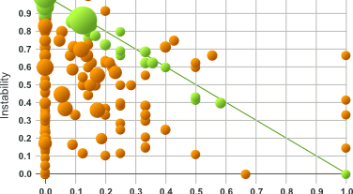
JDepend’s D-Metric

Slide 55
Distance from the Main Sequence (D)
The perpendicular distance of a package from the idealized line A + I = 1. This metric is an indicator of the package's balance between abstractness and stability.
A package squarely on the main sequence is optimally balanced with respect to its abstractness and stability. Ideal packages are either completely abstract and stable (x=0, y=1) or completely concrete and instable (x=1, y=0).
The range for this metric is 0 to 1, with D=0 indicating a package that is coincident with the main sequence and D=1 indicating a package that is as far from the main sequence as possible.

Slide 56
JDepend ant task (simple!)_x0010__x0010__x0010_
<target name="jdepend">
<jdepend format="xml" outputfile="docs/jdepend-report.xml">
<sourcespath>
<pathelement location="classes" />
</sourcespath>
<classpath location="classes" />
</jdepend>
<style basedir="docs" destdir="docs" includes="jdepend-report.xml" style="${ant.home}/etc/jdepend.xsl" />
</target>

Slide 57
Jmetric
OO metric calculation tool for Java code
http://www.it.swin.edu.au/projects/jmetric/products/jmetric/
Metrics
  Lines Of Code per class (LOC)
  Cyclomatic complexity
  LCOM (by Henderson-Seller)

Slide 58
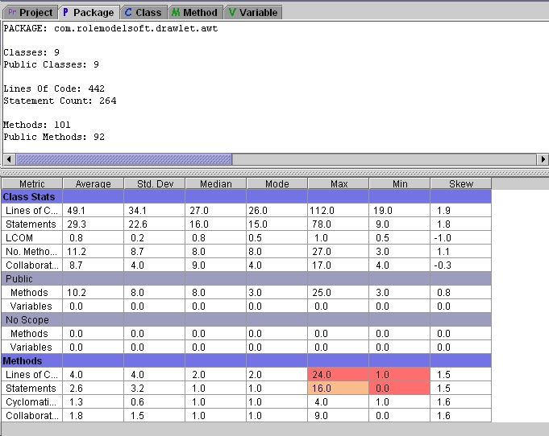
JMetric tool result

Slide 59
Aggregation and Composition
So far looked at individual measures
  Manager wants to know
    Is the code good overall
    Who is at fault
We need to know if we can aggregate
  What aggregate can be useful
    Average
    Weighted mean
Mordel et al “Software quality metrics aggregation in industry” Journal of software Evolution and Process 2013 Vol 25 pp 1117-35

Slide 60
Look at code example
Your code for coursework
  I will do a couple of simple examples to show why you need to be careful in this agregation process
  Look at LOC (lines of code) both as average and weighted mean

Slide 61
Build Systems
Want to look at the effect on quality
  Example from my GUI students
    What happens when I try to run their code
  Another paper
    “Quantitative Evaluation of Software Quality Metrics in Open-Source Projects” Barkmann, Lincke and Löwe 2009 International Conference on Advanced Information Networking and Applications Workshops
  Interesting conclusions from their experiment

Slide 62
Mavern led to “better quality”
Why?
  Look at the paper
    Basically standard layout leads to better reliability
    But code examples were all
      Open source
    So not necessarily professional coders

Slide 63
Correlation between metrics
See Barkmann paper
Coupling between objects and Data Abstraction Coupling (CBO and DAC)
Number of Local Methods (NOM) and
  Number of Abstract Methods (NAM) and Response for a class (RFC) and WMC (Weighted method Count)
And RFC and WMC

Slide 64
And finally
Building metrics for external quality
  More difficult
  How do you control your beta testers?
  How do you automate testing of a whole system?
  What about things like quality of service
    Experiment to show how QOS for a web site was affected by security features
    Generated thousands of hits through a script

Slide 65
Conclusions
Software metrics can give much useful information about the quality of code
They allow comparisons between projects, developers and teams and over time
They suggest areas for improvement and give early warnings of problems (as in manufacturing process metrics)
They need to be interpreted with some care as not all projects/tasks are equal
Management need to know what quality problems exist but
  Developer should know what needs corrected

